Slide 1

ENGINEERING CHEMISTRY
Asha A
Department of Science and Humanities

Slide 2

ENGINEERING CHEMISTRY
Module 6- Corrosion Chemistry
Class content:
Types of electrochemical corrosion
Stress corrosion
Caustic embrittlement
Factors affecting rate of corrosion

Slide 3
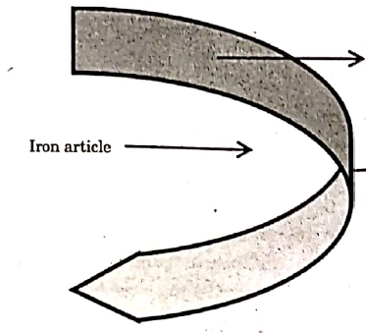
ENGINEERING CHEMISTRY
Module 6- Corrosion Chemistry
Stress Corrosion:
Also called Stress Corrosion Cracking(SCC)
A type of corrosion that occurs when some part of the metallic material
is under stress and exposed to specific corrosive environment
During the manufacture or fabrication of the articles, when the metals
are subjected to mechanical operations such as pressing, hammering,
rolling, bending, quenching, welding and riveting
The stress can be external stress acting on the metal during service conditions or residual stress or both
Stress free iron
Source: Basuchandra’s Engineering chemistry, Banbayalu (2014)
Stressed Iron

Slide 4
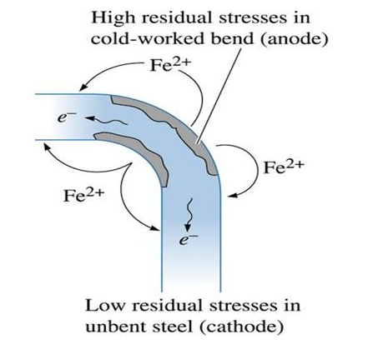
ENGINEERING CHEMISTRY
Module 6- Corrosion Chemistry
Due to stress a crack is initiated
The metal atoms under stress are always at higher energy levels therefore becomes more reactive than the stress free part
As a result, a corrosion cell is formed with the stressed part acting as anode and the stress free part acting as cathode
Source:https://slideplayer.com/slide/8594552/

Slide 5
ENGINEERING CHEMISTRY
Module 6- Corrosion Chemistry
Conditions for stress corrosion:
Tensile stress
Specific corrosive environment
Under specific corrosive environment the stressed part undergoes
corrosion
The crack deepens and results in the breakdown of the structure
Specific corrosive environment :
Brass - ammoniacal solution or ammonia vapours
Steel – NaOH and chloride ions
Causes serious damage – air crashes, bridge collapses, boiler explosions

Slide 6
ENGINEERING CHEMISTRY
Module 6- Corrosion Chemistry
Caustic embrittlement of boilers:
A form of stress corrosion that takes place in boilers operating at high
temperature and pressure, at the stressed regions of the boilers like
rivets, joints etc.
Water boilers made of mild steel undergo corrosion at the stressed
portion when exposed to concentrated alkali

Slide 7
ENGINEERING CHEMISTRY
Module 6- Corrosion Chemistry
Corrosion mechanism in water boilers:
When water is boiled, Na₂CO₃ present in boiler water is hydrolysed at
high temperature to give NaOH
NaOH thus formed, enters the fine hair line cracks that may be present at
the stressed portion of the boiler through capillary action
Due to the high temperature, NaOH gets concentrated and when
concentration of NaOH reaches 10 % , it dissolves the Iron around it
2NaOH + Fe → Na₂FeO₂ + H₂
The product sodium ferroate(Na₂FeO₂)undergoes further hydrolysis
regenerating NaOH and Fe₃O₄ is produced which is brittle in nature
3Na₂FeO₂ + 4H₂O → Fe₃O₄ + H₂ + 6NaOH

Slide 8
ENGINEERING CHEMISTRY
Module 6- Corrosion Chemistry
Cracks propagate along intergranular path which sometimes reults in explosion of the boiler
Since concentrated caustic soda is recognized as the specific environment required for stress corrosion of water boiler, this type of corrosion is called as caustic embrittlement
The corrosion cell can be represented as follows:
Fe under stress (Anode)/Concentrated NaOH/Dilute NaOH/Fe stress free (Cathode)
Can be prevented by the addition of corrosion inhibitors such as sodium sulfate, tannin, lignin, phosphates etc.

Slide 9
ENGINEERING CHEMISTRY
Module 6- Corrosion Chemistry
Nature of the metal
Difference in electrode potential of anode and cathode
Nature of corrosion product
Ratio of anodic to cathodic area
Factors affecting rate of corrosion
Overvoltage
Polarisation
pH
Temperature
Conductivity of the medium
Humidity

Slide 10
ENGINEERING CHEMISTRY
Module 6- Corrosion Chemistry
Nature of the metal:
Metals with lower electrode potential values are more
reactive than the metals with higher electrode potential values
More reactive metals are more susceptible to corrosion
Metals like K, Na, Mg, Zn etc., with low electrode potential values are
highly susceptible for corrosion
The noble metals such as silver, gold, platinum etc., with higher
potential values are less susceptible for corrosion
Electrochemical series should give an idea of the order in which metals
undergo corrosion
But metals like Chromium, Aluminum Titanium etc. are exceptions as
they are passive
Galvanic series is required which arranges metals and alloys in the order
of their tendency to undergo corrosion in a particular environment

Slide 11
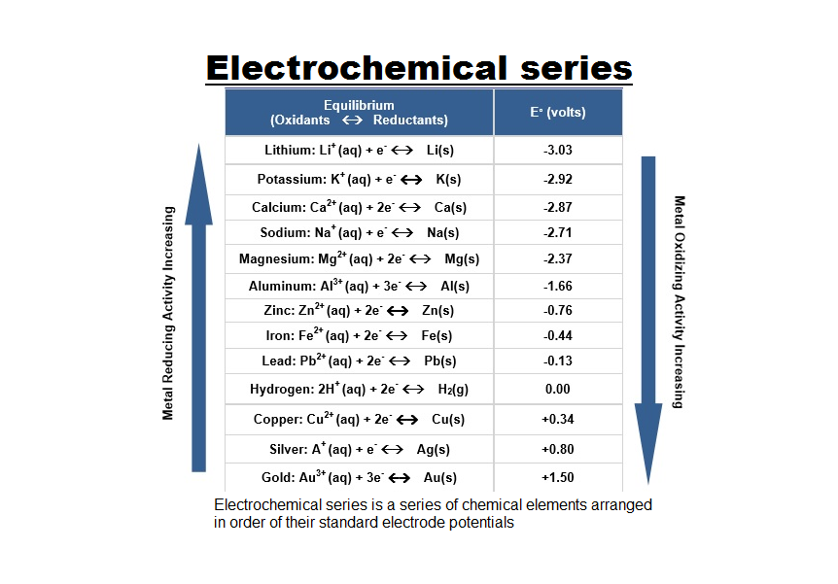
ENGINEERING CHEMISTRY
Module 6- Corrosion Chemistry
The electrochemical series is built up by arranging various redox equilibria in the order of their standard electrode potentials (redox potentials). The most negative E° values are placed at the top of the electrochemical series, and the most positive at the bottom
Source:https://www.syedgilanis.com/2019/04/electrochemicalseries.html

Slide 12
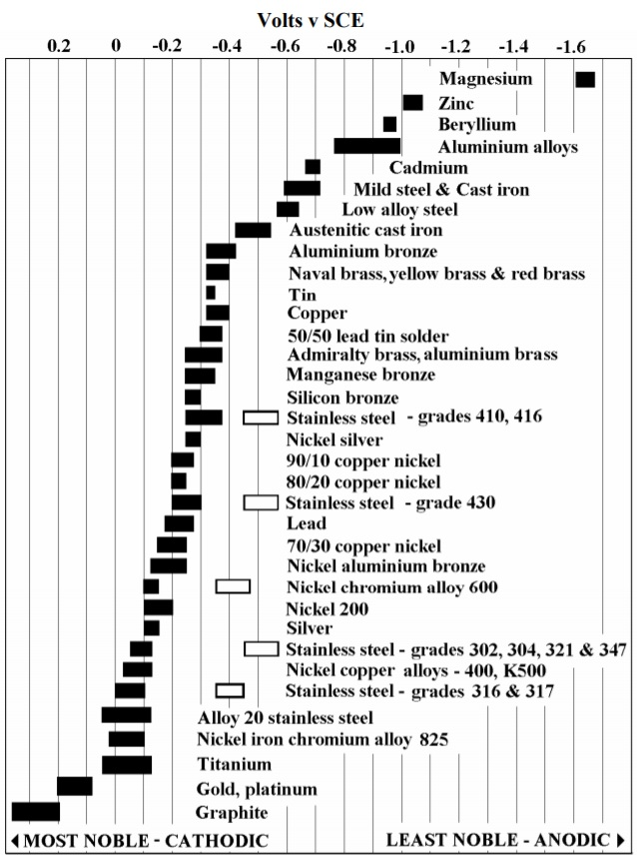
ENGINEERING CHEMISTRY
Module 6- Corrosion Chemistry
Galvanic Series
A “galvanic series” lists metal and alloys in order of their tendency to undergo corrosion in a particular electrolyte solution, hence for each specific solution which is expected to be encountered for actual use, a different order will ensue
Sorce: https://www.corrosionpedia.com/an-introduction-to-the-galvanic-series-galvanic-compatibility-and-corrosion/2/1403

Slide 13
ENGINEERING CHEMISTRY
Module 6- Corrosion Chemistry
Difference in potential between anodic and cathodic region:
Larger the potential difference between the anodic and cathodic
regions, higher is the rate of galvanic corrosion
When potential difference is more, the free energy decrease
accompanying the process is higher and the corrosion rate is also
higher
Therefore when two different metals with large difference in their
electrode potentials are in contact with each other, the more
reactive metal undergoes corrosion very fast

Slide 14
ENGINEERING CHEMISTRY
Module 6- Corrosion Chemistry
For example,
Case I :
Fe (-0.44V) and Cu(0.34V); the potential difference is 0.78 V
Case II
Fe(-0.44V) and Sn(-0.14V); the potential difference is 0.3 V
Corrosion of Fe is faster when it is in contact with Cu
The use of dissimilar metals should be avoided wherever possible,e.g., nuts and bolts should be made of the same metal. Otherwise, the anodic metal gets corroded.

Slide 15
ENGINEERING CHEMISTRY
Module 6- Corrosion Chemistry
Nature of the corrosion product:
For some metals like Chromium, Aluminum etc.,the corrosion product formed on the surface of the metal acts as a protective film
If the corrosion product deposited is insoluble, stable, uniform, and non porous, it acts as a protective film preventing further corrosion of metal
A thin, invisible, impervious, continuous film formed on the surface acts as a barrier between the fresh metal surface and the corrosion environment

Slide 16
ENGINEERING CHEMISTRY
Module 6- Corrosion Chemistry
On the other hand metals like iron, zinc, magnesium, etc., do not form protective film on the surface of the metal
If the corrosion product is soluble, unstable, non uniform, and
porous, the corrosion continues unabated
In such cases, the fresh metal surface is continuously exposed to the
corrosion environment and corrosion of the metal takes place
continuously
Steel gets corroded but stainless steel does not

Slide 17
THANK YOU
Asha A
Department of Science and Humanities

